Slide 1
Before I Begin…
I wanted to make the most out of this course and project, so I decided to use a subset of the data that I collected this semester, instead of using other data introduced throughout the course, to explore for any intriguing patterns.

Slide 2
K-means vs. PAM, Which Is Better For My Data?
DATA 824 Final Capstone Project
Young Ju Ryu

Slide 3

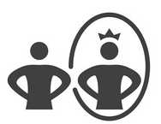
Reaction to Failure
!
?
Intellectual Failure
Receptive
Face weakness
“How to improve”
Defensive
Ignore weakness
“How to feel better”

Slide 4
!
Receptivity to Failure
?
↔ Defensiveness
Promotes self-awareness, learning, performance, and growth (Diner & Dweck, 1978; Sedikides & Strube, 1997; McCrea & Hirt, 2001)
Eventually affects interpersonal, organizational, and societal level benefits (Argyris, 2002; Baumeister & Cairns, 1992; Howell et al., 2017)

Slide 5
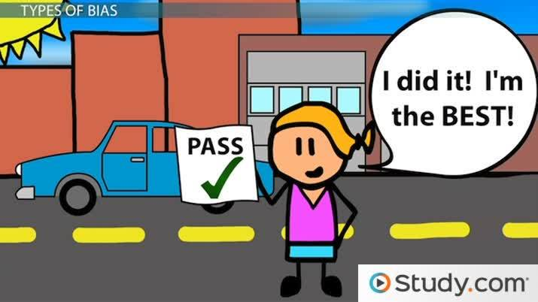
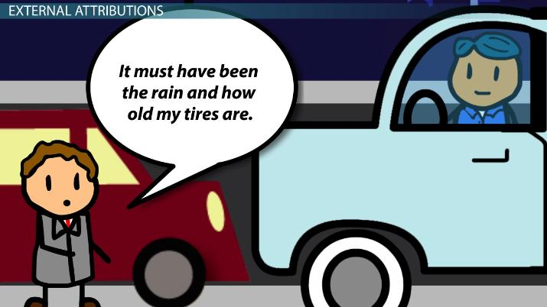
Defensiveness
!
?
Self-serving biases: As failure undermines self-worth, individuals search for external (vs. internal) factors to attribute the failure to (Weiner, 1985)

Slide 6
The Current Data
!
?
The dataset is a subset of a larger dataset that investigated the relationship between intellectual humility and defensiveness
Apart from addressing the primary research questions, my additional interest lay in exploring how various attribution sources would cluster together in our data
→ More specifically, this project aims to compare two different clustering methods (K-means and PAM) to determine which might be a more suitable method for this dataset.

Slide 7
Data Collection - Participants
!
?
459 SONA participants were invited to the lab
These participants had enrolled in the introductory psychology course (PSYC 104) for the Fall 2023 semester. The majority were Freshmen (n = 380)
18 participants were excluded from the final dataset for either not providing consent or failing to pass the attention check item
The final dataset comprised 441 (298 Women, 137 Men, 4 Nonbinary, 3 Other)

Slide 8
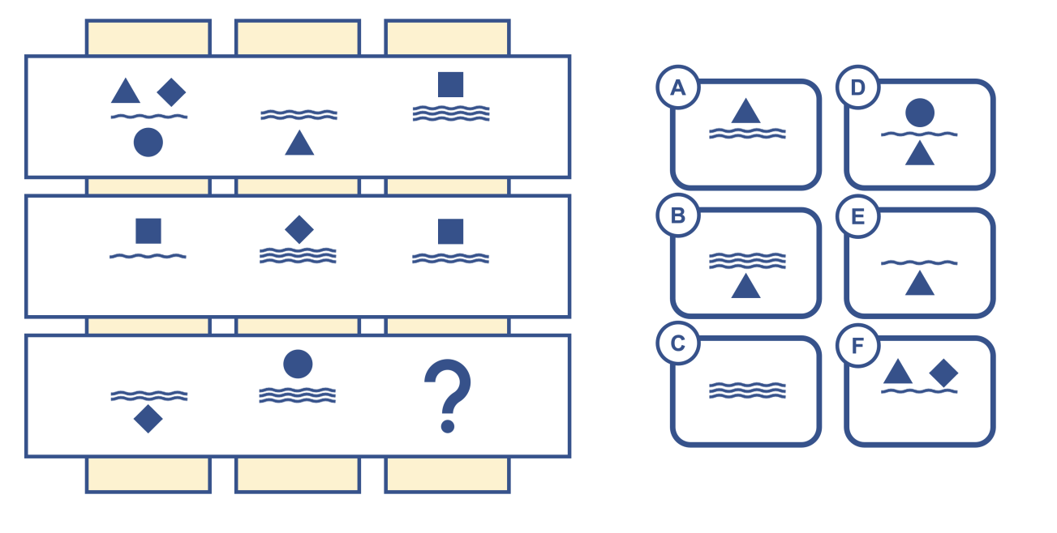
Data Collection - Procedure
!
?
Participants were asked to take a “cognitive performance test”
Materials selected from: Pattern Recognition Task (https://www.intelligencetest.com/questions/pattern-recognition/)
- 5 difficult quizzes → thus intended to be a failure experience
- e.g.,

Slide 9
Data Collection - Procedure
!
?
2. Participants were subsequently given feedback on their performance
Out of 5 quizzes, you answered # correctly (# / 5).
To help you understand how your problem-solving skill compares to others, prior studies show that 67% of individuals within your peer group answered all five quiz items correctly.
True feedback
False information

Slide 10
Data Collection - Procedure
!
?
3. Participants rated the extent to which they perceived each factor as influencing their performance on the problem-solving task, using a 7-point Likert scale (1: No effect, 7: Strong effect)
How well-rested you are
Level of effort
Difficulty of the task for most other people
Luck
Your current mood
The testing conditions
Your lack of problem-solving skills
Difficulty of the task specifically for me

Slide 11
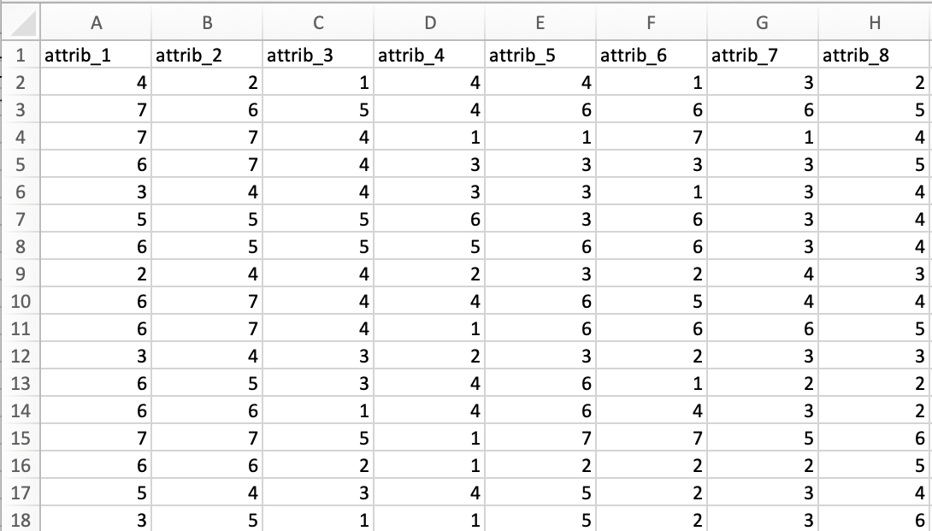
The Current Data
!
?
Consists of 8 columns
Each represents different attribution sources
Attrib_1: How well-rested you are
Attirb_2: Level of effort
Attrib_3: Difficulty of the task for most other people
Attrib_4: Luck
Attrib_5: Your current mood
Attrib_6: The testing conditions
Attrib_7: Your lack of problem-solving skill
Attrib_8: Difficulty of the task specifically for me

Slide 12
Questions
!
?
Some of the attributions are clearly external (e.g., luck), while others are distinctly internal (e.g., lack of problem-solving skill)
However, certain attributions fall into a more ambiguous category (e.g., difficulty of the task)
This ambiguity sparked my curiosity about how these attributions might cluster together
Additionally, I was interested in exploring the variations in results produced by different clustering methods

Slide 13
Shiny App
!
?
To address the aforementioned curiosities, I created an app that contrasts two specific clustering methods of my choice: K-means and PAM
I selected K-means, considering its widespread use in the field of Social Psychology
Since K-means and PAM have comparable characteristics (e.g., use of centroids vs. medoids), I selected PAM for comparison
Additionally, users have the flexibility to set the number of clusters

Slide 14
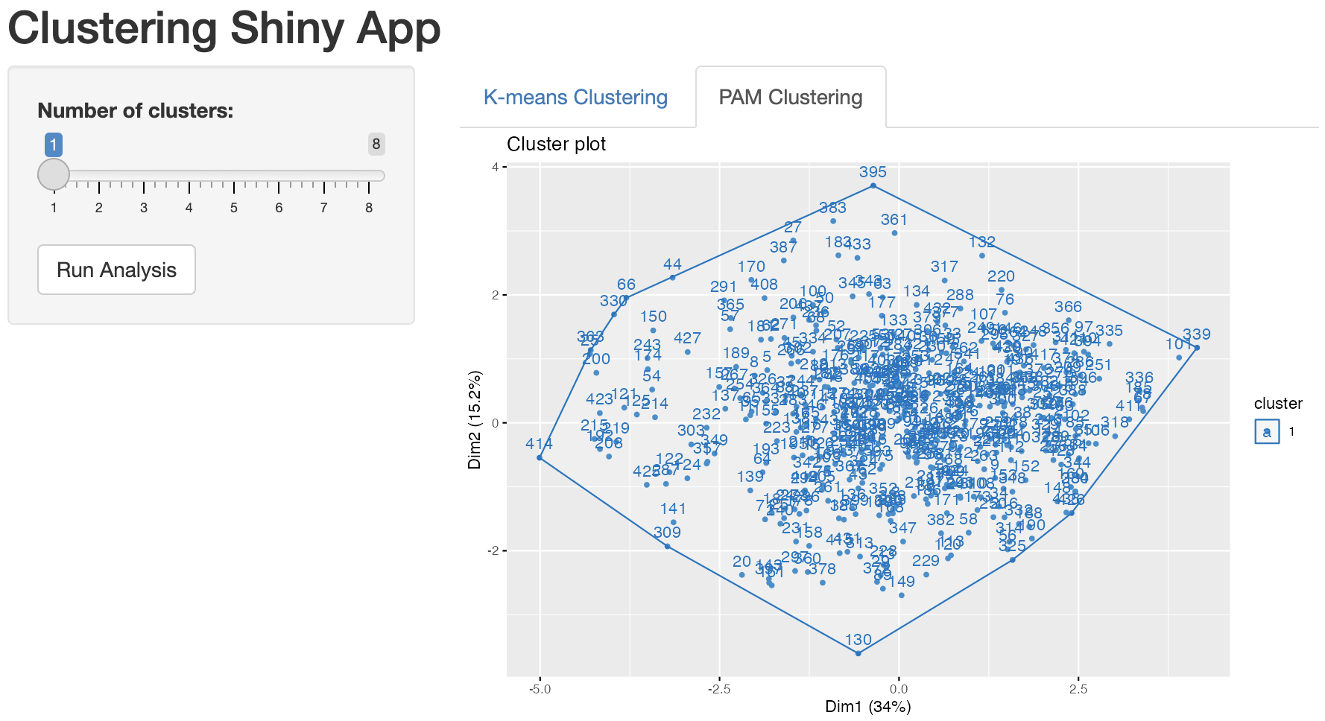
Results (Number of Clusters = 1)
!
?
I set the minimum number to 1 in case one would prefer to have a clearer overview of all data

Slide 15
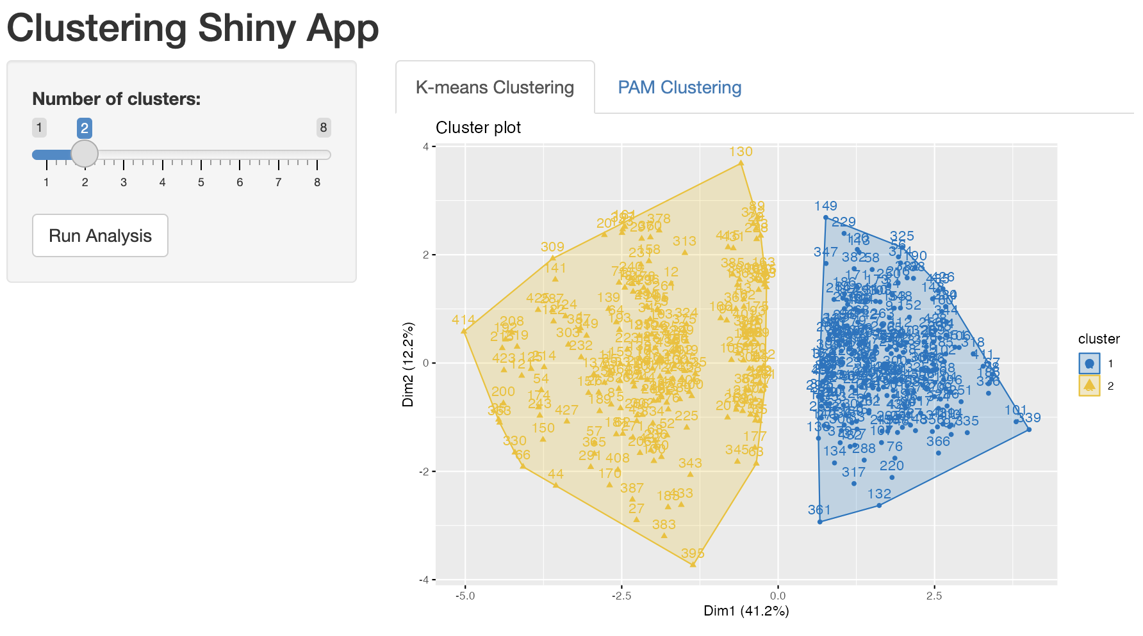
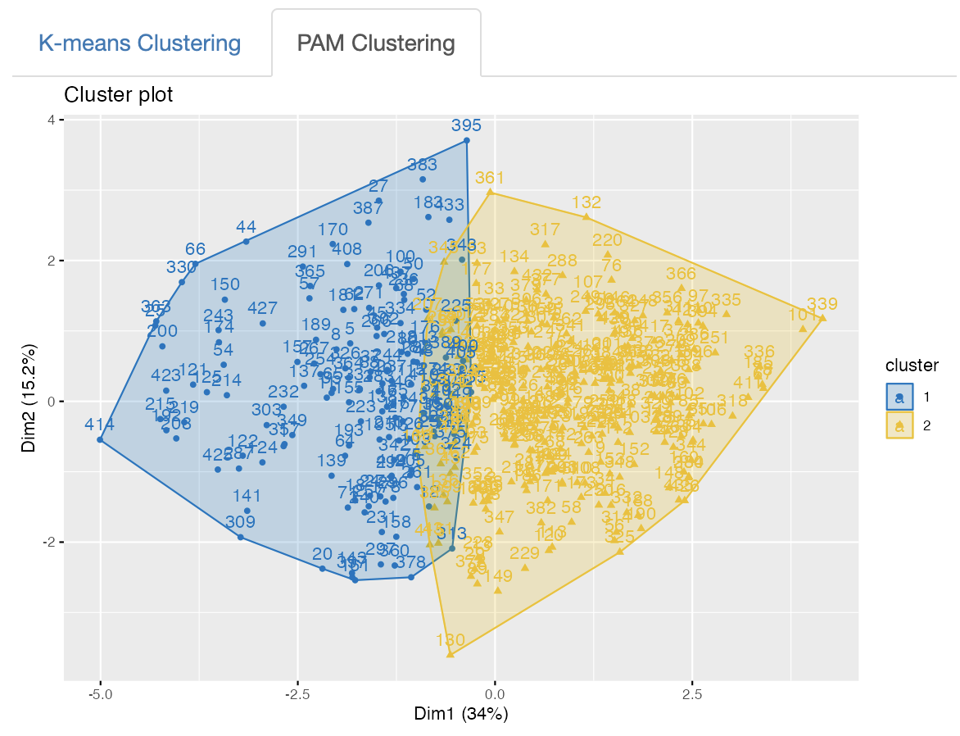
Results (Number of Clusters = 2)
!
?
Clusters were similarly distinguished in both methods, but K-means was more distinct

Slide 16
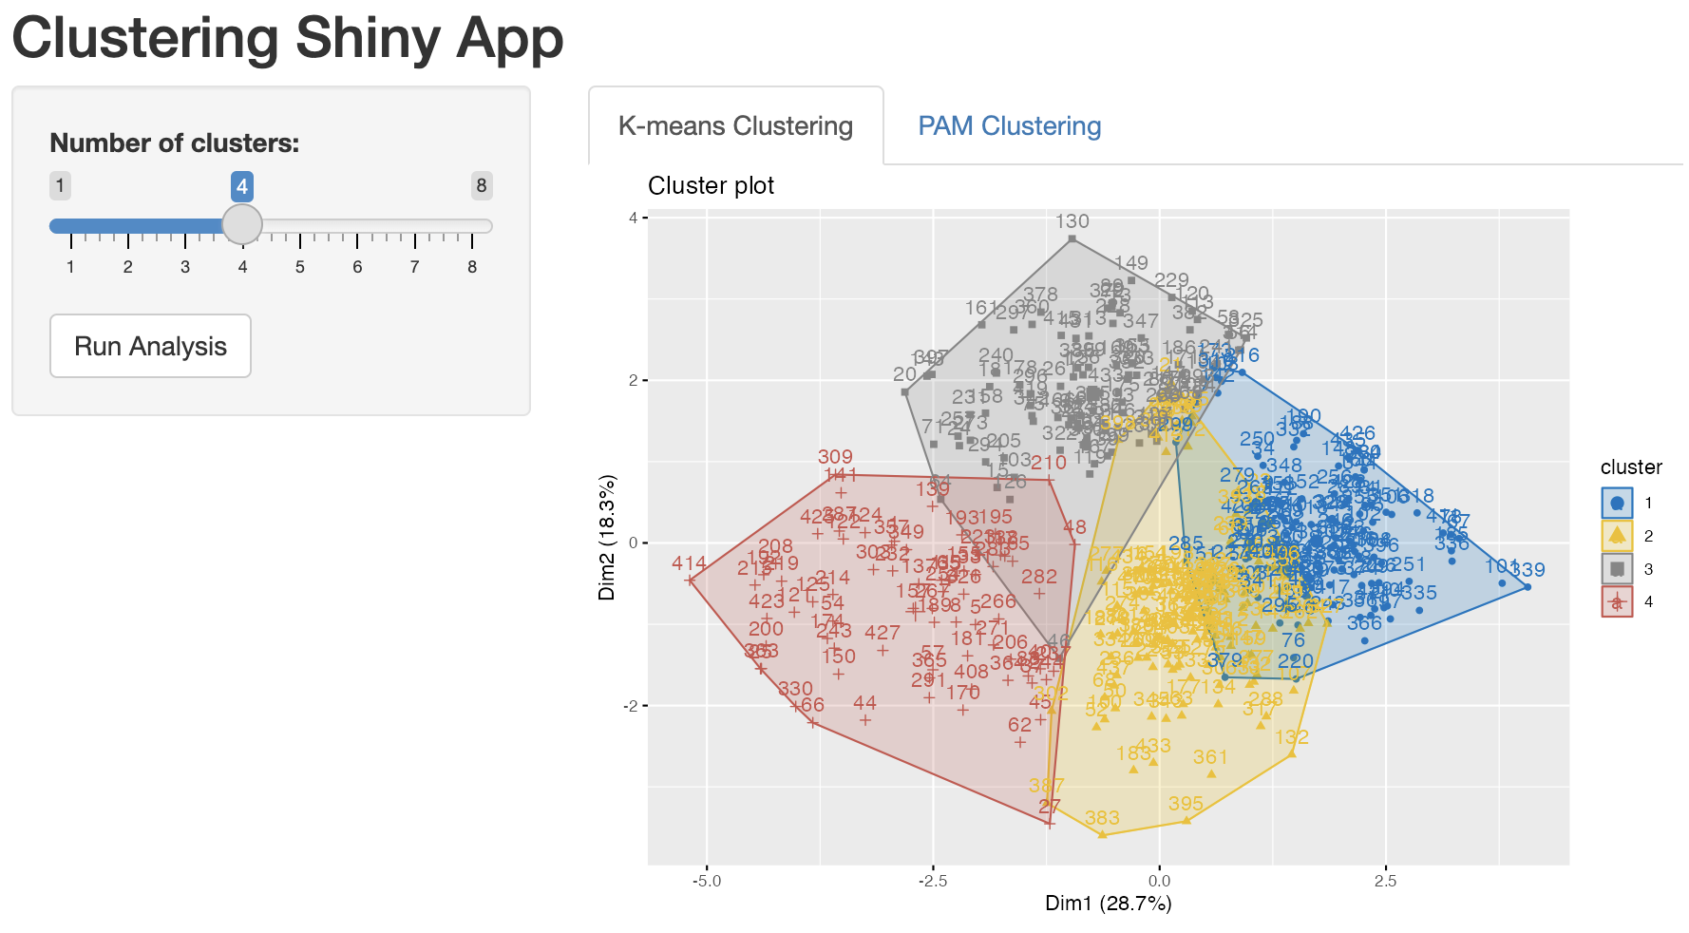
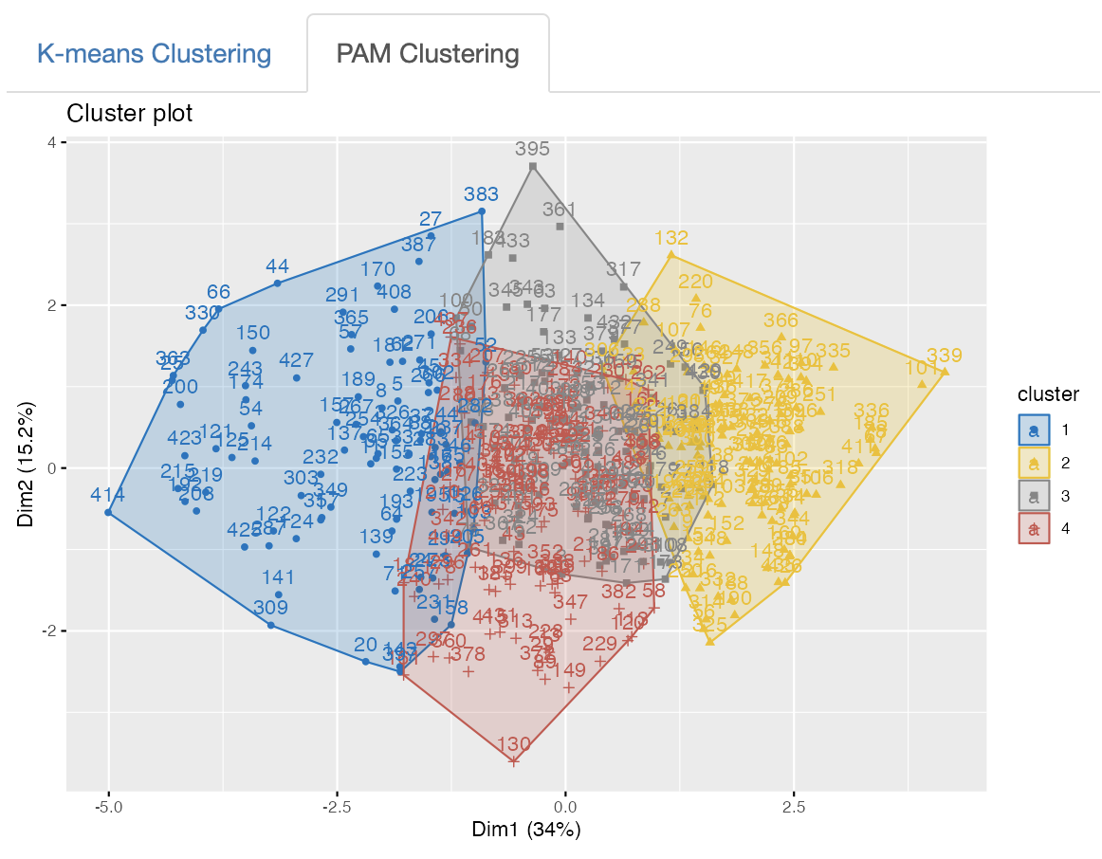
Results (Number of Clusters = 4)
!
?
Again, it appears that K-means performed better at distinguishing each cluster

Slide 17
Discussion
!
?
Results from other numbers of clusters are not reported here, but overall, K-means clustering with two clusters appears to yield the best result in our data.

Slide 18
Discussion
!
?
The primary goals of this project: determining the better method (K-means vs. PAM) and identifying the optimal number of clusters Building on these results, further exploration can be conducted:
Examine which attributes are more likely to cluster together
Test potential differences between clusters concerning other variables in the original data (e.g., intellectual humility or agreeableness)
This app serves as a quick guide to selecting an effective clustering method

Slide 19
Thank You

